Slide 1
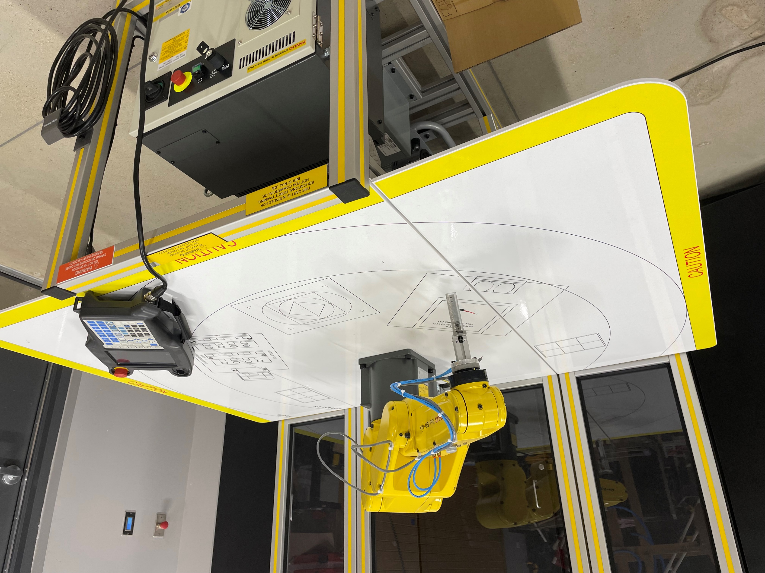
Advanced Manufacturing and Machinery Mechanics
Statewide Program of Study
Manufacturing Career Cluster
The Manufacturing Career Cluster focuses on planning, managing, and performing the processing of materials into intermediate or final products and related professional and technical support activities such as production planning and control, maintenance, and manufacturing/process engineering.
The Advanced Manufacturing and Machinery Mechanics program of study focuses on the assembly, operation, maintenance, and repair of electromechanical equipment or devices. CTE learners may work in a variety of mechanical fields, gaining knowledge and experience in robotics, refinery and pipeline systems, deep ocean exploration, or hazardous waste removal. CTE concentrators may work in a variety of fields of engineering.
Work-Based Learning and
Expanded Learning Opportunities
Secondary Courses for High School Credit
1 Principles of Applied Engineering
2 Robotics I
3 Robotics II
4 Engineering Design & Presentation I
Exploration Activities | Work-Based Learning Activities
Participate in FIRST Robotics Competition (FRC) | Work at a local business or industry apprenticeship Join the American Welding Society
Industry-Based Certifications
FANUC Robot Operator 1
Postsecondary Opportunities
Associates Degrees
Electromechanical Engineering/Technology
Certified Quality Technician
Industrial Mechanics and Maintenance Technology
Bachelor’s Degrees
Electrical Engineering
Industrial Engineering
Mechanical Engineering
Master’s, Doctoral, and Professional Degrees
Electrical Engineering
Industrial Engineering
Mechanical Engineering
FANUC Robot in SMHS Robotics Lab
Aligned Occupations
Occupations | Median Wage | Annual Openings | % Growth
Electro-Mechanical Assemblers | $30,160 | 951 | 9%
Electro-Mechanical Technicians | $56,555 | 127 | 9%
Industrial Machinery Mechanics | $49,816 | 3,788 | 27%
Successful completion of the Advanced Manufacturing and Machinery Mechanics program of study will fulfill requirements of the Business and Industry or STEM endorsement if the math and science requirements are met. Revised – August 2022

Slide 2
Advanced Manufacturing and Machinery Mechanics Course Information
COURSE NAME | SERVICE ID | PREREQUISITES | COREQUISITES
Principles of Applied Engineering | 13036200 (1 credit) 6749 | None (strongly recommended: Algebra I) | None
Robotics I | 13037000 (1 credit) 6730 | Principles of Engineering | None
Robotics II | 13037050 (1 credit) 6735 | Robotics I | None
Engineering Design & Presentation I | 13036500 (1 credit) 6541 | Algebra I / Principles of Engineering | None
FOR ADDITIONAL INFORMATION ON THE MANUFACTURING CAREER CLUSTER,
PLEASE CONTACT: CJ Odam, SMCISD CTE Coordinator cj.odam@smcisd.net
San Marcos CISD does not discriminate on the basis of race, color, national origin, sex, disability or age in its programs or activities and provides equal access to the Boy Scouts and other designated youth groups. The following person has been designated to handle inquiries regarding the nondiscrimination policies: Stephanie Munoz ; 631 Mill St, San Marcos, TX 78666 ; 512-393-6700 ; stephanie.munoz@smcisd.net
Further nondiscrimination information can be found at smcisd.net/cte

